Slide 1
New Jersey
Real Estate Trends
Jonathan Groth
Inna Baloyan
Michael Rutkowski
Ketal Vyas
Rutgers Data Science Coding Bootcamp-October 2018

Slide 2
Objective
To locate the right town for those who wish to live in NJ.
People will have a chance to weigh the factors that are important to them.
These are based on the following:
-Property Taxes -School Ratings
-Proximity to NJ Transit -Crime Rate
-Restaurants -Shopping
When users rank the factors that are important to them from 1 ( not important at all ) to 10 ( the most important ) for above listed fields, they get the optimal zip code for the specific town they will choose to live in.

Slide 3
Data Resources
We used Property, Point of Service, and Community APIs of DataATTOM.com, the leading real estate database. Kaggle NJ income dataset and criminal raings from www.patch.com/nj were also used.
Python/Jupyter Notebook was useful to load .json and .csv data into MLab ( MongoDB ) hosted by Amazon Web Services; python Flask and Pymongo to pull data for our Machine Learning models.
Finally, we used Decision Tree Regression and Random Forest algorithms to predict house prices and identify the important features.

Slide 4
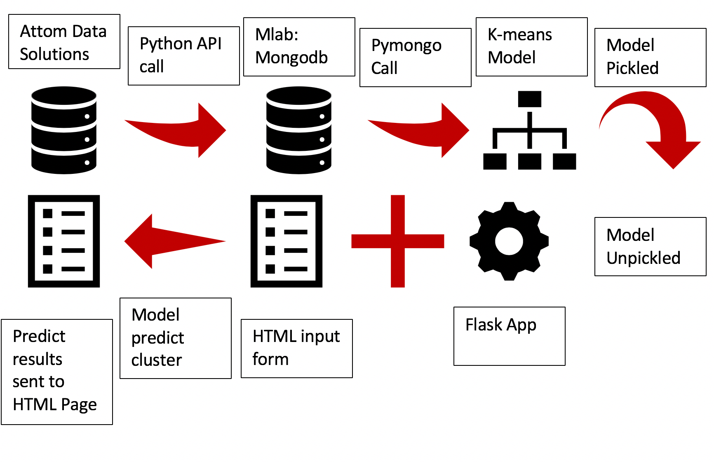
Workflow Stack

Slide 5
Points to Consider
k cluster “center” points are created at various random locations.
or each observation:
the observation is assigned to cluster of nearest center point.
distance between each observation and k centered points is computed.
3. Center points are moved to means (viz. centers) of their own respective clusters.
4.The last two steps are repeated until no more observation changes in cluster membership.

Slide 6
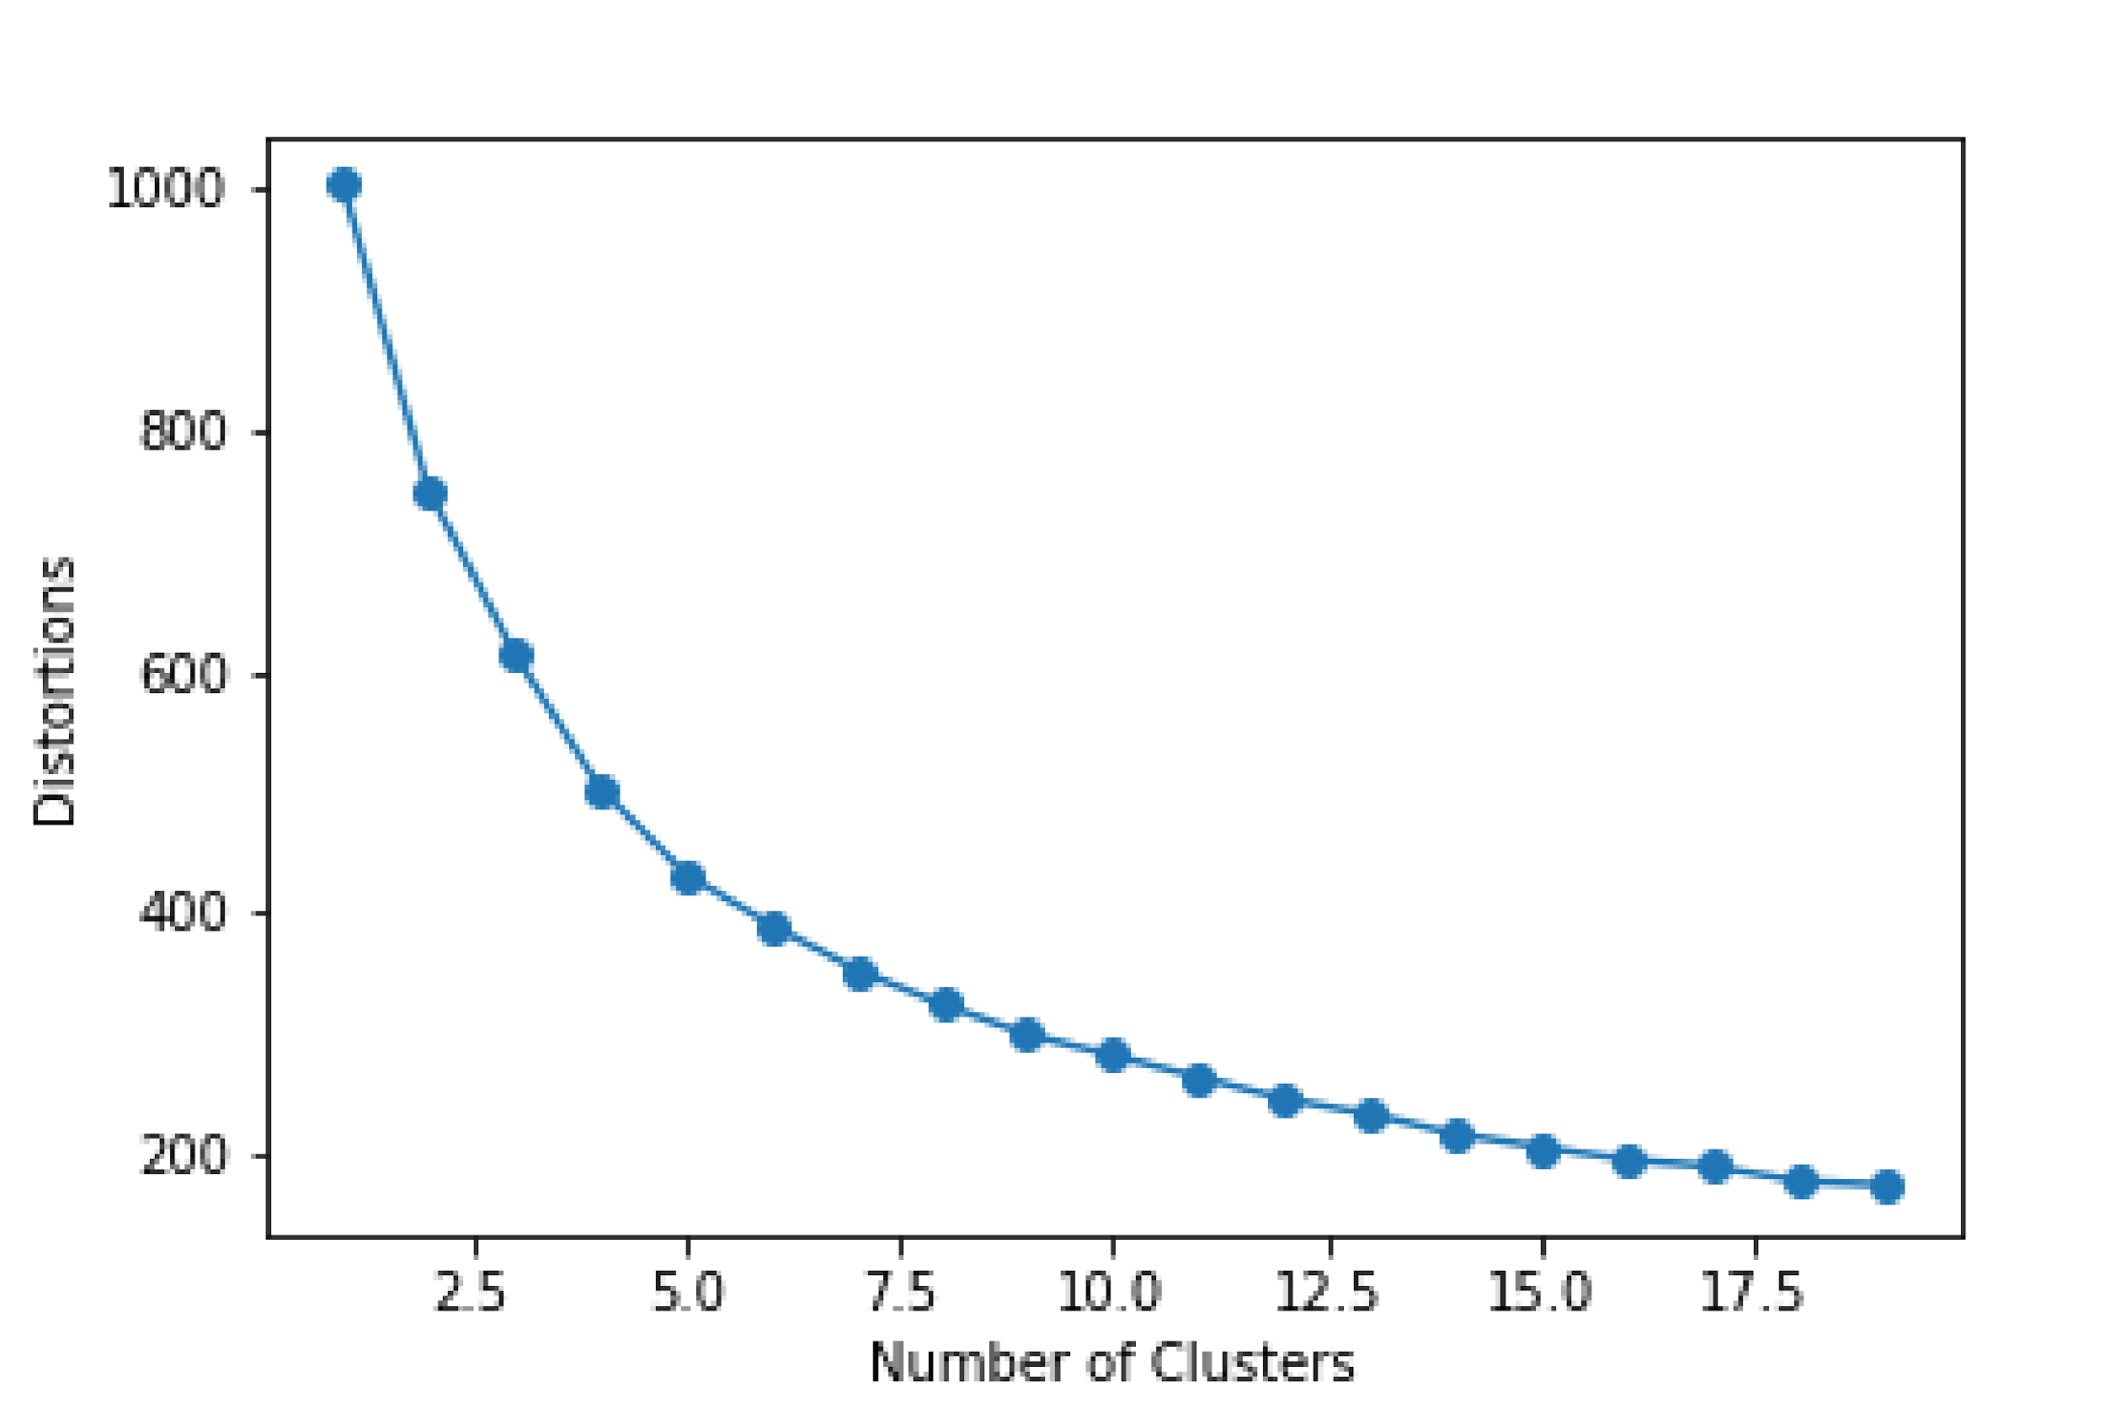
Elbow Plot

Slide 7

Demonstration
Demonstration

Slide 8
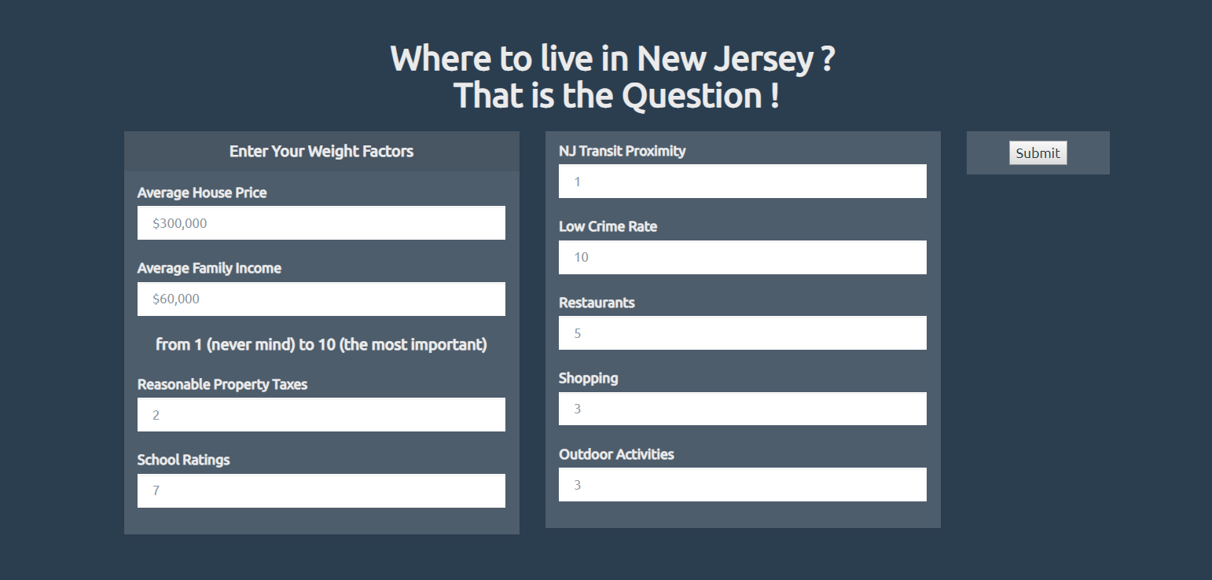

Slide 9
Questions?

